Slide 1





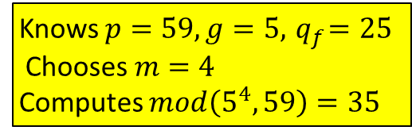
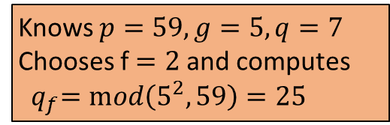
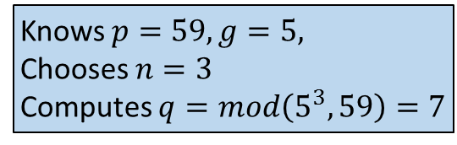
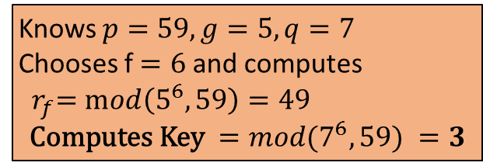
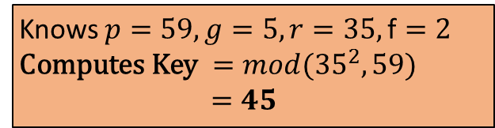
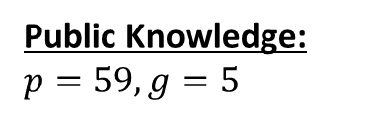
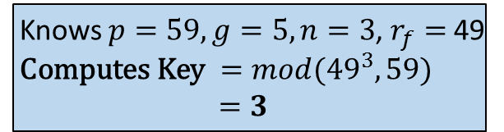

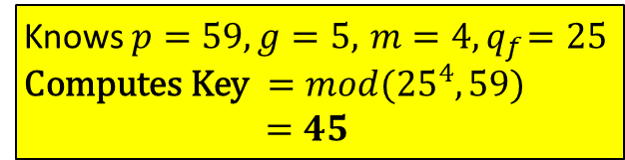

Public Knowledge: $p=59, g=5$
Moses
Fred
Knows $p=59, g=5, \text{Chooses} n=3$
Computes $q=mod\left(5^{3},59\right)=7$
Sends $q=7$
Knows $p=59, g=5,q=7$
Chooses f $=2$and computes
${ q}_{f}=mod\left(5^{2},59\right)=25$
Knows $p=59, g=5, n=3$, $r_{f}=$49
$\text{Computes} \text{Key} ={mod(49}^{3},59)$ $=3$
Knows $p=59, g=5,q=7$
Chooses f $=6$and computes
${ r}_{f}=mod\left(5^{6},59\right)=49$
$$\text{Computes} \text{Key} ={mod(7}^{6},59) =3$$
Sends $r_{f}=$49
Sends${ q}_{f}=25$
Knows $p=59, g=5,r=35,\text{f}=2$
$\text{Computes} \text{Key} ={mod(35}^{2},59)$ $=45$
Rachael
Sends $r=35$
Knows $p=59, g=5,{ m=4, q}_{f}=\text{25} \text{Computes} \text{Key} ={mod(25}^{4},59)$ $=45$
Knows $p=59, g=5,{ q}_{f}=25 \text{Chooses} m=4$
Computes $mod\left(5^{4},59\right)=35$

Slide 2


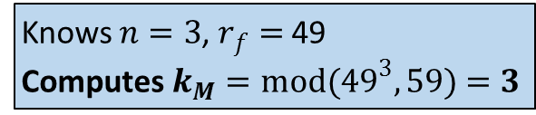
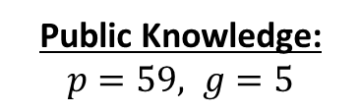
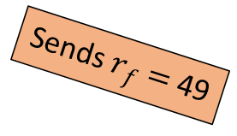
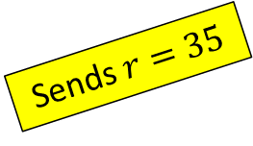
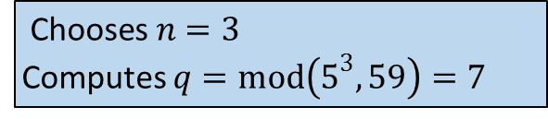
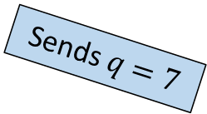
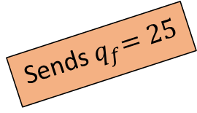
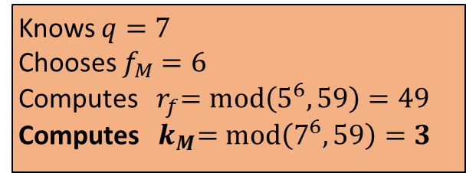
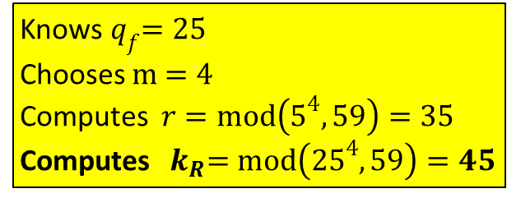
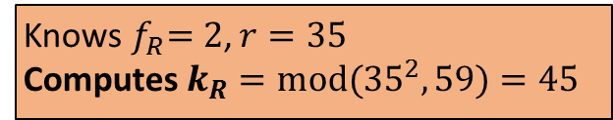
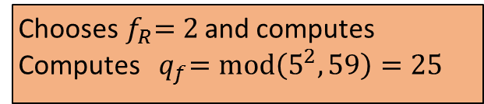
Public Knowledge: $p=59, g=5$
Moses
$\text{Chooses} n=3$
Computes $q=mod\left(5^{3},59\right)=7$
Fred
Knows $n=3$, $r_{f}=$49
$\text{Computes}{ k}_{M}={mod(49}^{3},59)$ $=3$
Sends $q=7$
Knows $q=7$
Chooses $f_{M}$ $=6$
Computes ${ r}_{f}=mod\left(5^{6},59\right)=49$
Computes ${ k}_{M}=mod\left(7^{6},59\right)=3$
Sends $r_{f}=$49
Chooses${ f}_{R}=2$ and computes
Computes ${ q}_{f}=mod\left(5^{2},59\right)=25$
Rachael
Sends${ q}_{f}=25$
Knows${ q}_{f}=25$
Chooses $m$ $=4$
Computes $r=mod\left(5^{4},59\right)=35$
Computes ${ k}_{R}=mod\left({25}^{4},59\right)=45$
Knows${ f}_{R}=2$, $r=35$
$\text{Computes}{ k}_{R}={mod(35}^{2},59)$ $=45$
Sends $r=35$

Slide 3





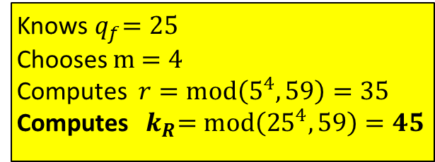
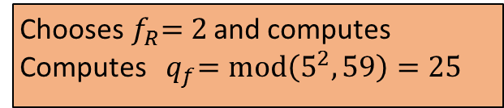
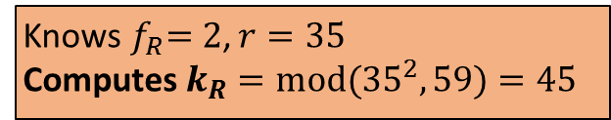
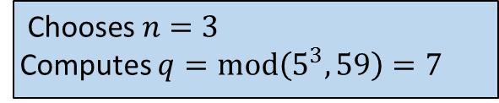
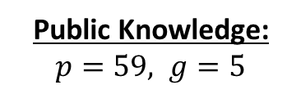
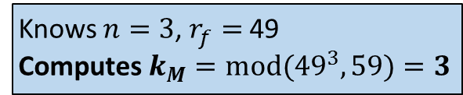


Public Knowledge: $p=59, g=5$
Moses
Sends $q=7$
$\text{Chooses} n=3$
Computes $q=mod\left(5^{3},59\right)=7$
Fred
Knows $n=3$, $r_{f}=$49
$\text{Computes}{ k}_{M}={mod(49}^{3},59)$ $=3$
Knows $q=7$
Chooses $f_{M}$ $=6$
Computes ${ r}_{f}=mod\left(5^{6},59\right)=49$
Computes ${ k}_{M}=mod\left(7^{6},59\right)=3$
Sends $r_{f}=$49
Sends${ q}_{f}=25$
Chooses${ f}_{R}=2$ and computes
Computes ${ q}_{f}=mod\left(5^{2},59\right)=25$
Rachael
Knows${ q}_{f}=25$
Chooses $m$ $=4$
Computes $r=mod\left(5^{4},59\right)=35$
Computes ${ k}_{R}=mod\left({25}^{4},59\right)=45$
Knows${ f}_{R}=2$, $r=35$
$\text{Computes}{ k}_{R}={mod(35}^{2},59)$ $=45$
Sends $r=35$

